Slide 1
Innovative Tools and Approaches in Long-term Ecological Restoration of World Heritage Natural Areas
Partnerships, Emerging Technologies and Sustainable, Novel Resourcing Strategies
Authors: Drs Aila Keto AO & Keith Scott
Presenter: Virginia Young
Australian Rainforest Conservation Society
Notes:
• In the next seven minutes, 266 hectares (or 1.6 km x 1.6 km) of forest worldwide will be lost.
• Species and life-support systems of this planet are decaying faster than we can heal them
• My question to you is:
“what can each of us do better to tip the balance back in favour of Nature?”
• I hope the learnings from our project might help.

Slide 2
We recover cloud forests
New National Parks even from cow paddocks
Heart of the Gondwana World Heritage
National /International biodiversity hotspot
A paradigm shift - think ecological time!
A 20-year long-term commitment by ARCS
Notes:
• We recover cloud forests on newly created National Parks in the heart of the Gondwana Rainforests of Australia World Heritage Area — a national and international hotspot of biodiversity.
• Success in restoring and protecting biodiversity depends on paradigm shifts — we have to accept future national parks are sometimes built from cow paddocks, not just pristine areas; we have to think in ecological timeframes not just the here and now.
• We have committed 20 years to this project

Slide 3
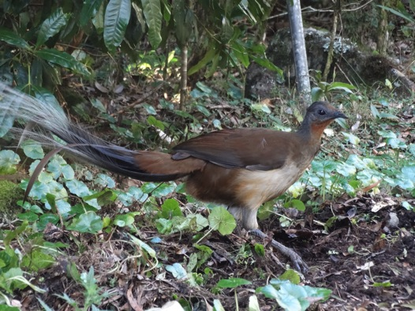
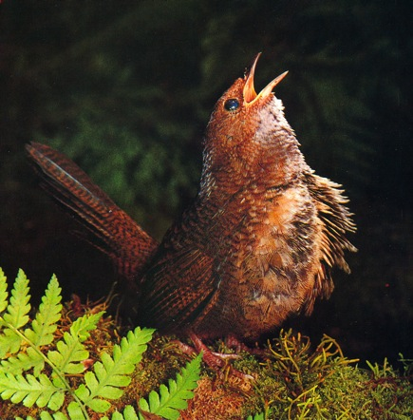
Why?
Albert’s Lyrebird
Photo Greg Nye
Oldest songbirds
Rufous Scrub-bird
Photo: Michael Morcombe
Notes:
Why?
• because our passion and focus is World Heritage — the very pinnacle of World Parks
• because our driving fear is losing such refugia that have protected ancient lineages of life for millennia
— the oldest songbirds on earth (the lyrebird and scrub-bird lineages) and
— the basal lineages of so many other radiations that transformed the Earth’s biodiversity
• These are a fundamental underpinning of Outstanding Universal Value of this World Heritage Area
• We restore their critical habitats, link them and try to ensure the resilience they need

Slide 4
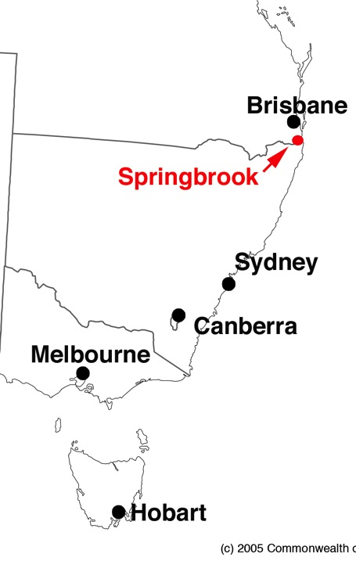
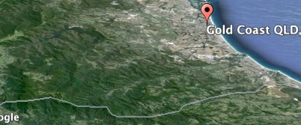
Where?
Notes:
Where?
To orientate you, the Springbrook Plateau is:
— the most easterly edge of Australia (map)
— the wettest place in Australia bar Tasmania and the Wet Tropics
— and so, most importantly, it is one of the closest modern analogues of paleoclimates in which these ancient lineages first evolved
— these climatically stable refugia are where the morphologically and functionally conservative ancient lineages can best survive future climate change
For the sake of long-term viability of the Outstanding Universal Value of a World Heritage area, we have to aim to achieve HISTORIC FIDELITY, not ‘NOVEL’ ecosystems as some scientists promote

Slide 5
Case Study 11
p. 96
Notes:
AN INTERNATIONAL CASE STUDY
You’ll all recognise this IUCN report
• Our project is one of IUCN’s 12 international Case Studies.
• We are testing the practical effectiveness of the Society for Ecological Restoration Primer — our main guide
• Their 9 end goals of success are fine but how do you measure them in practice?
• If you can’t measure, you can’t manage!
• We have 39 monitoring projects. The details are on our Springbrook Rescue website: www.springbrookrescue.org.au
• We focus here only on the 5 topmost leanings and innovations.

Slide 6
Ecological conceptual models are indispensible
Notes:
FIRST KEY LEARNING
“ Ecological conceptual models are indispensible”
• It makes explicit how we think nature works.
• Otherwise we’re in the dark — unable to learn enough from Nature — especially the “if, when and how” to intervene.
• Old prescriptions are not enough to ensure long-term integrity, stability or resilience of restored areas.
• Three key drivers (in the dark green box) and 3 response variables (in the pale green) in our model are the basis of our monitoring program
• We focus today only on the Resources & Climate driver (bottom right-hand side of slide)

Slide 7
A Revolution in Monitoring
Autonomous WSN
175 nodes
700 sensors
1.2 km² catchment
A world first!
Real time
Relevant scales
Notes:
SECOND KEY LEARNING
“Emerging smart technologies can revolutionize environmental monitoring”
• Together with the Commowealth Scientific and Industrial Research Organisation (CSIRO) and former Queensland Government, ARCS helped establish an autonomous, solar-powered, wireless sensor network to monitor the physical limits on ecological restoration — in real time and spatial scales that mater.
• We established 175 nodes and 700 sensors in a 1.24 square km sub-catchment — a world first in design and scale

Slide 8
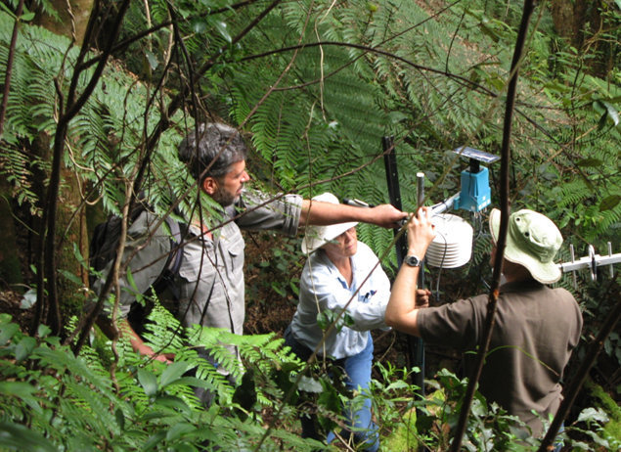
Testing data transition from inside forest site with Yagi antenna
Notes:
THE RESULTS ARE REVEALING
• most significantly and surprisingly it helped reveal:
(a) the most stable areas of the refugium — the critically important areas to restore and protect
(b) why plants grow and thrive where they do and, importantly, where intervention is NOT needed — saving critical time and resources
(c) the critical importance of “facilitation” in species interactions — a grossly understated or ignored ecosystem process in restoration.
— In fact palaeo-endemics (old endemics or relicts) with conservative traits can depend on neo-endemics (modern plants), even weeds, especially weeds, for successful recruitment in stressful environments.

Slide 9
Long-term ecological restoration Long-term resourcing solutions
Our Business Model
All profits from ecotourism
In-kind support based on Social Learning
• Grants, philanthropy –only augment
Notes:
THIRD KEY LEARNING — “RESOURCING HAS TO BE SUSTAINABLE”
“long-term ecological restoration projects need long-term resourcing solutions”
• Most project failures are due to resourcing constraints — the vagaries and unreliability of grants, philanthropy and government support
• We opted for a business model based primarily on:
— cash revenue from ecotourism facilities, run by ARCS where all profits are directed to ecological restoration – a way of turning ‘in-kind’ to cash
— in-kind support from community groups that increases social learning
• Initiated in 2008, this business model served us well through the GFC and other external crises such as unprecedented floods that impact on tourism
• We expect it to continue to provide the core capital component of an initial 10-year $3.5 million budget

Slide 10
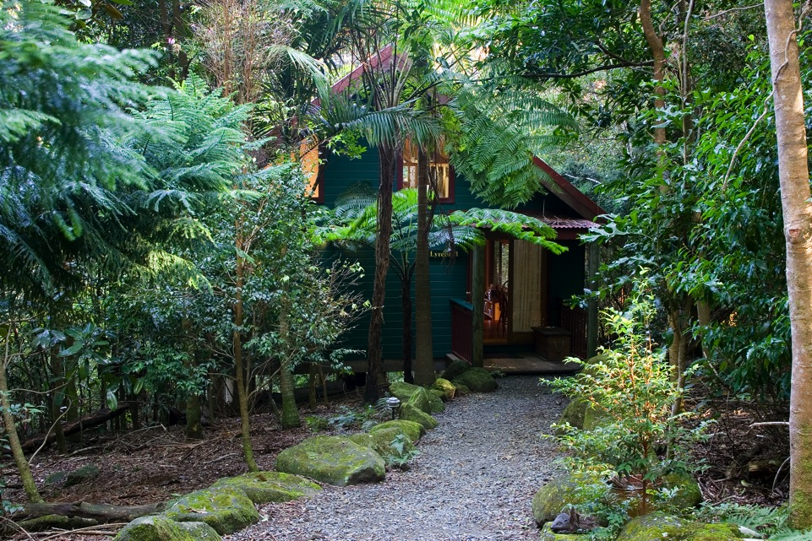
Springbrook Lyrebird Retreat
Notes:
OUR “LYREBIRD RETREAT’ RESORT funds ecological restoration
— a view of one of four high quality cabins at our low volume, high value accommodation centre
— the retreat is on land purchased by the Queensland Government
— ARCS bought the retreat to fund the restoration work
— it is a way of converting our pro bono management input into vital cash that provides the base funding for the project

Slide 11
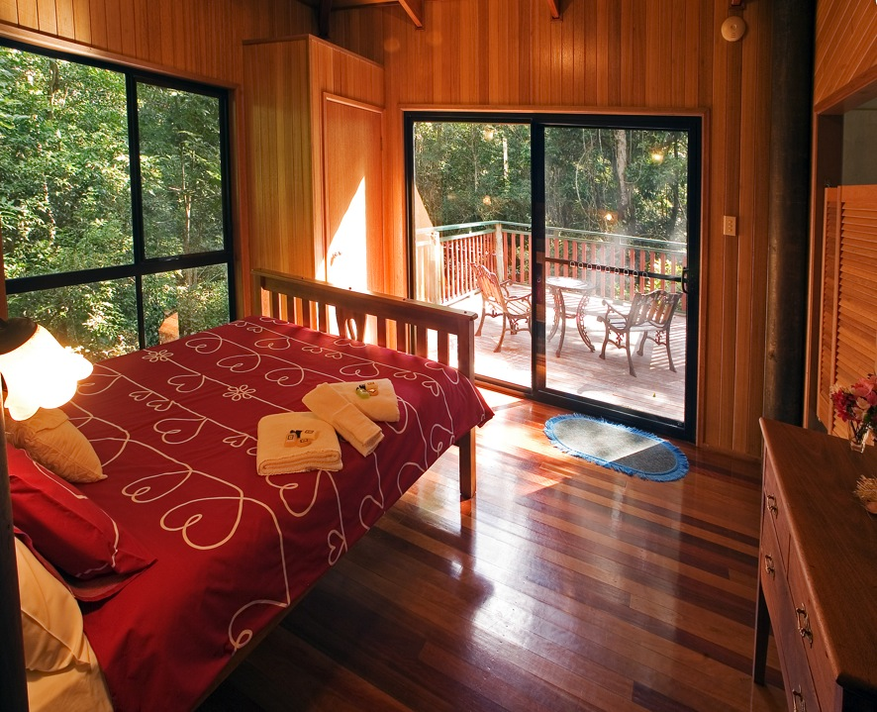
Notes:
Inside one of the quality cabins at Lyrebird Retreat

Slide 12
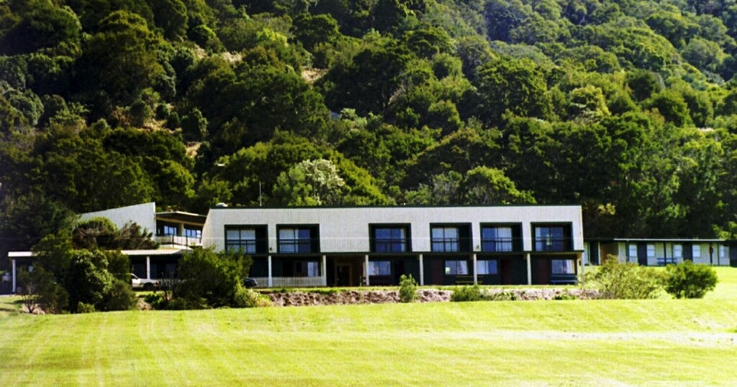
Koonjewarre – community/convention centre
Notes:
KOONJEWARRE
— our second business is a high volume/low value business accommodating up to 150 visitors from schools, community groups, universities or convention delegates
— located in the heart of the ancient cloud forest zone of the Gondwana Rainforests of Australia World Heritage area, surrounded by mountains, deep gorges and rare wildlife

Slide 13
Partnerships Political – ephemeral Community - enduring
Notes:
FOURTH KEY LEARNING
“ Social partnerships are vital”
Only those partnerships with the community are enduring and can catalyse, through social learning, the changes and environmental recovery that Nature needs

Slide 14
To restore balance in Nature’s favour Rekindle people’s passion for Nature
Notes:
Our business model critically depends on partnerships with a wide range of business and community groups
— birdwatchers, bushwalkers, church groups, scouts, Rotary and bushcare
— the model builds on the concept of mutual benefit from volunteerism and deep, inspiring reconnection with Nature
— Nature not only heals itself, but us too, so that we can better help it
— This is the answer to the original question at the beginning — “what can each of us do better to tip the balance in favour of Nature?”

Slide 15
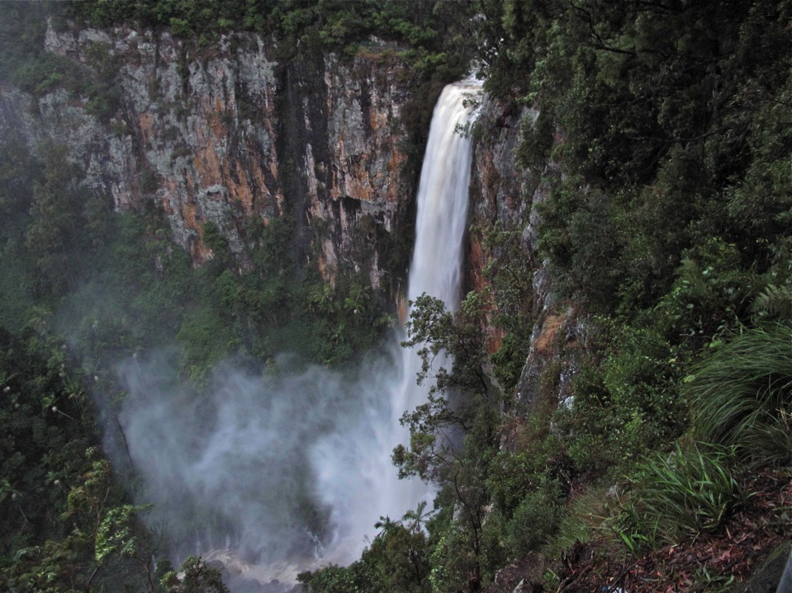
Awe
changes
us …
Notes:
AWE CHANGES OUR BRAINS
• The experience of AWE has the capacity to change the way we think, our perceptions of time, our willingness to give — and our sense of well-being grows;
• We want to make a difference in the world — this is REAL social learning. It works.
• The standout group is Birds Queensland who have returned every three months for the past four and a half years — for a hectic program of restoration and scientific monitoring of bird communities that gives them joy.
— they feel inspired to make a difference

Slide 16
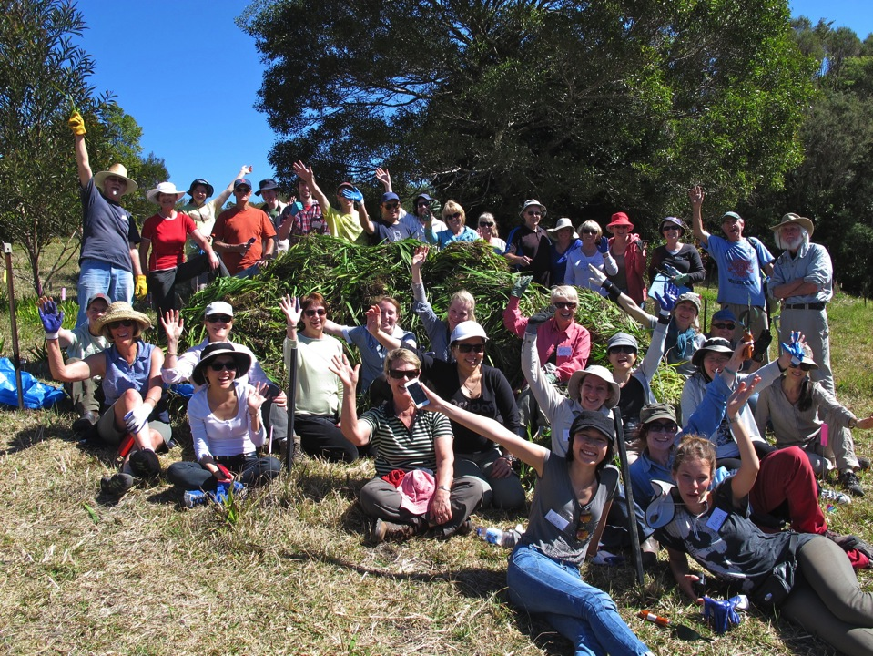
“Be inspired every day
to change the world”
Notes:
THE FIFTH LEARNING COMES FROM OUR VOLUNTEERS
The photo is of one of our groups surrounding the day’s cull of Aristea ecklonii — a forest-replacing weed capable of destroying our World Heritage
Each group such as this out of over 500 registered volunteers has discovered — If we are to make a difference:
“Be inspired every day to change the world”

